Slide 1
Lesson 10 pt 2
Aris Markogiannakis

Slide 2
Events
A React component has events that are used for the user to interact with a component.

Slide 3
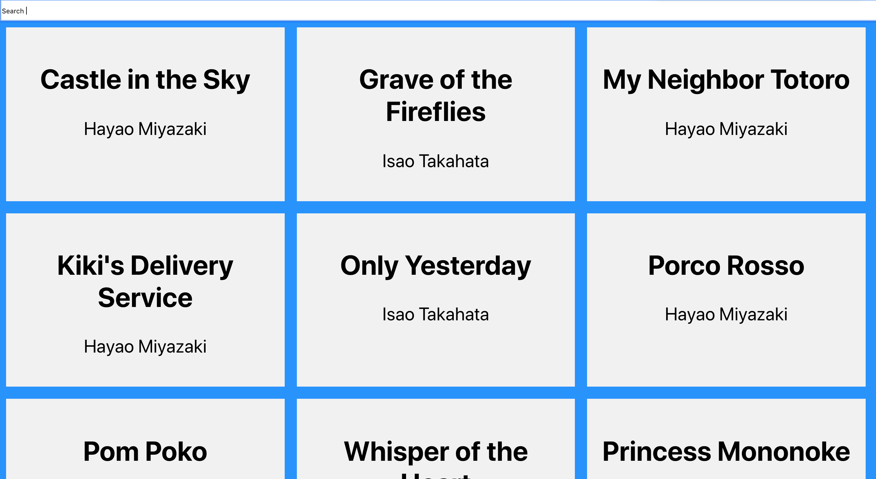
Search
We will add a Search Bar on the top of our existing app.
When we type a search keyword the list of movies will be able to be filtered by this search Item

Slide 4
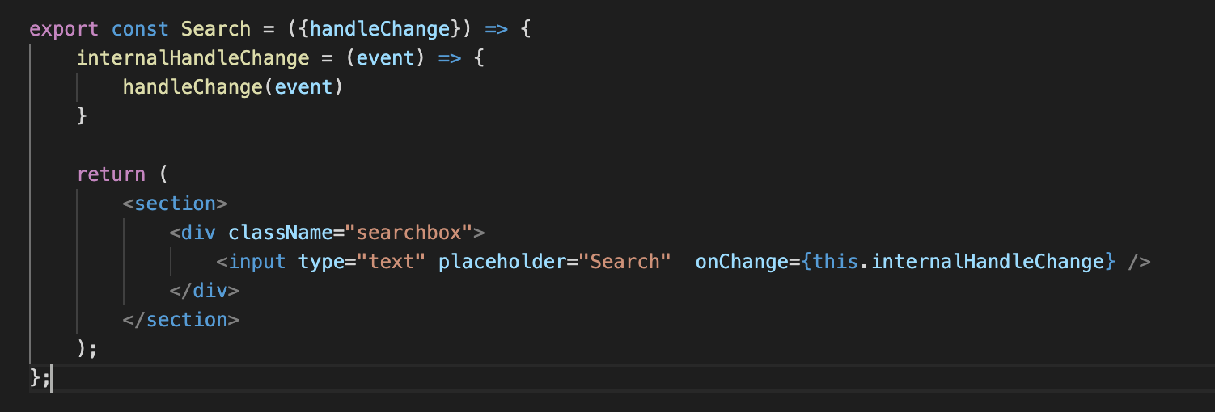
Events
To do so we will create a new component called Search.js inside the components folder.
Using destructuring we are able to get the property handleChange
Every element has a number of methods that we can attach a method
OnClick
OnChange
OnKeyUp
…

Slide 5
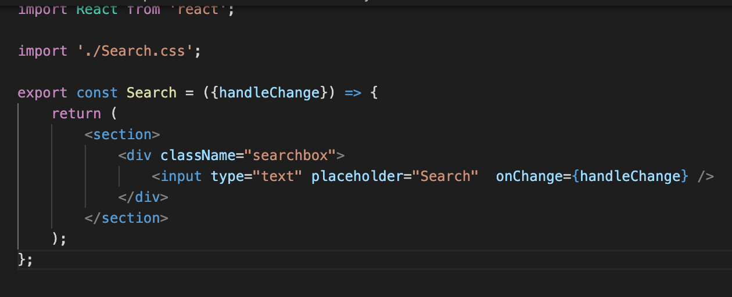
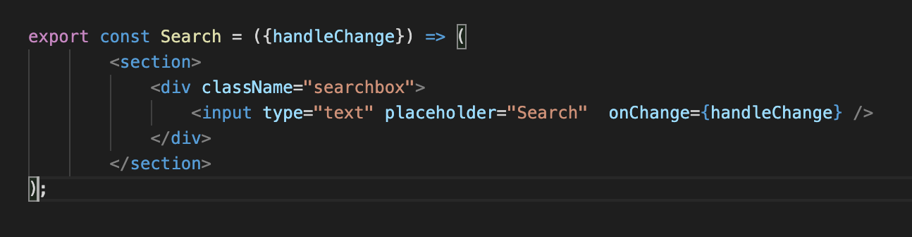
Simplification of code
This code can be simplied where we directly point to the property passed.
And because we use arrow function we can reduce the code even more.

Slide 6
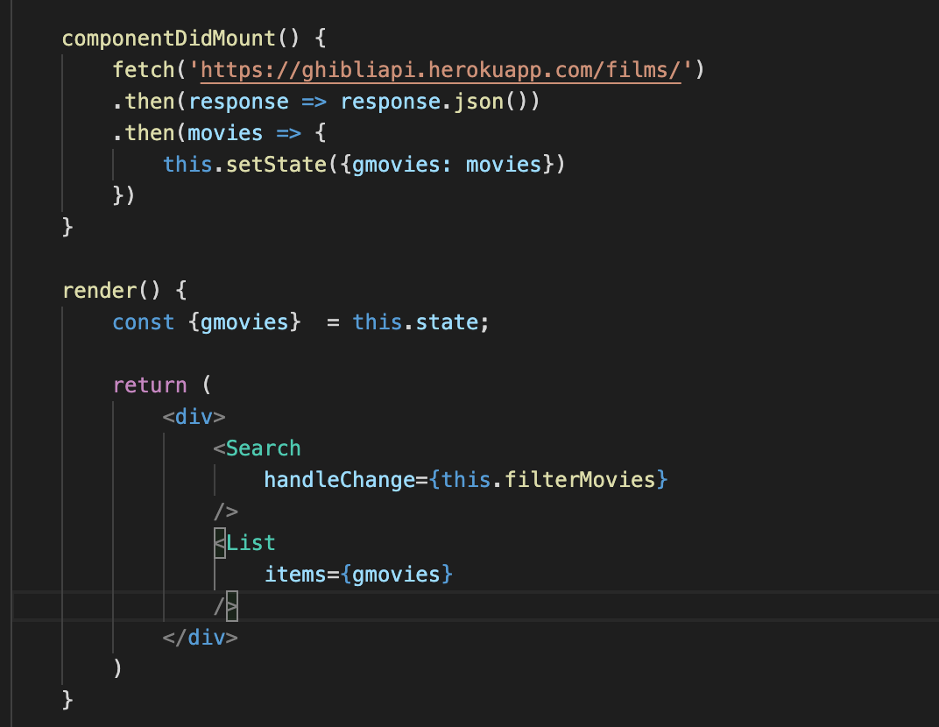
Two-way binding
This way we are returning the event to the parent component
The Search component passes to that property the filterMovies component

Slide 7
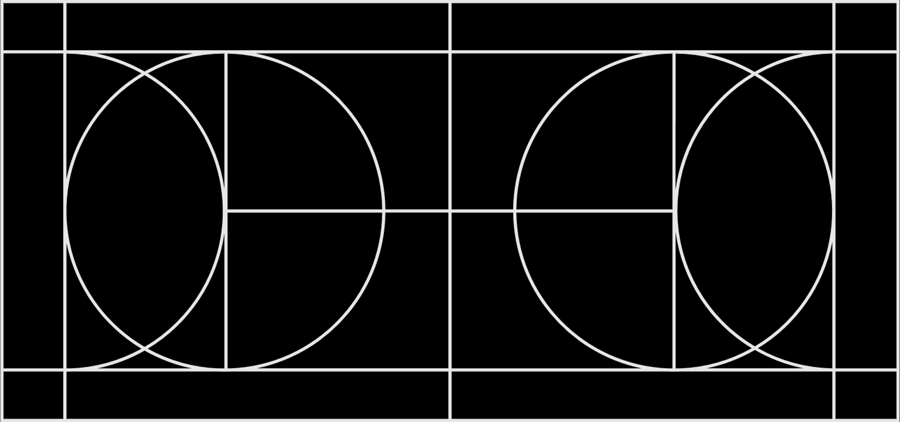
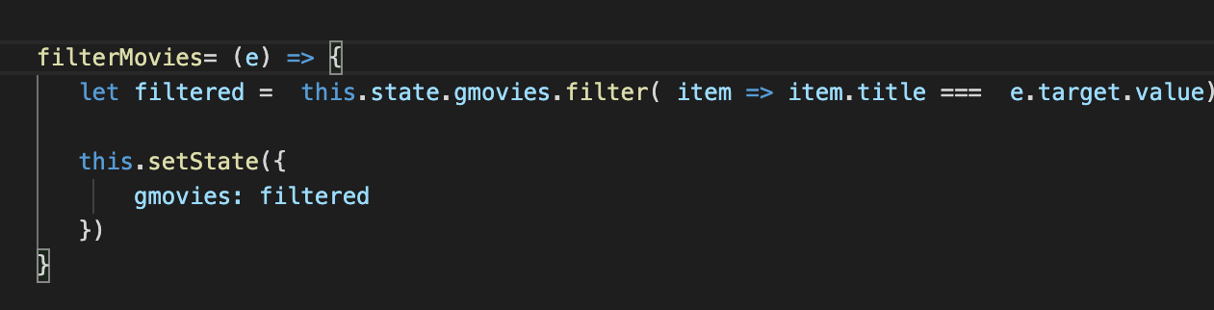
Eventhandler and Change of state
The function that handles the event:
is getting the movies using the this.state.gmovies
applies the method filter to find the movies with this title
and then set a new state using the this.setState

Slide 8
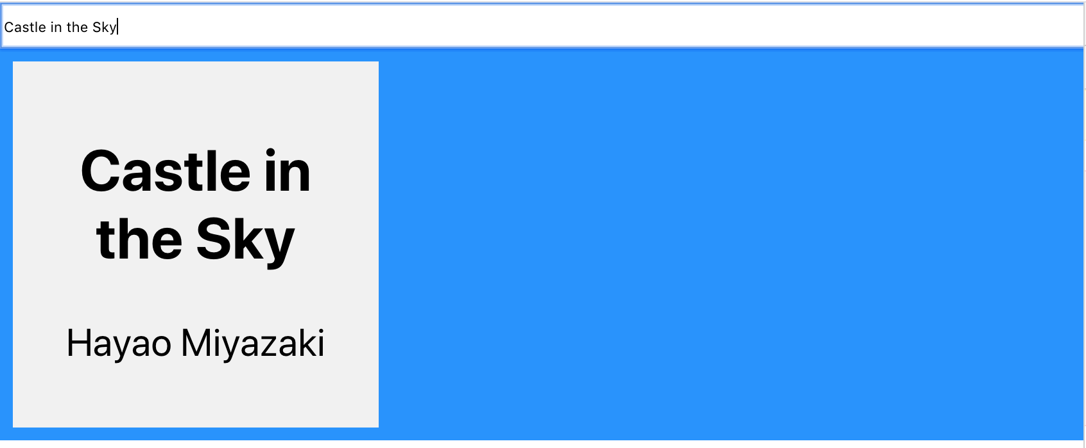
The result should be the following

Slide 9
Exercise 2
Let's try the exercise 2

